Slide 1
CIS092-1 Fundamentals of Study and Employability
Session duration: 2 hours
Session theme: How to Study – Learning Styles, Note Taking, use of VLE, mind mapping, time management
Lecturer: Upama Rai Cohort: Level 3 / Foundation Computing

Slide 2
How to Study Effectively
Topics:
  Learning preferences
  Active learning
  Note-taking
  Mind mapping
  Time management
  Using the VLE effectively

Slide 3
Learning Outcomes
By the end of this lesson, students should be able to:
  identify their preferred ways of learning
  distinguish between active and passive learning
  use an effective note-taking method
  organise information using a mind map
  create a realistic study plan
  use the VLE responsibly and
  Independently identify personal study habits that need improvement

Slide 4
What Does “How to Study” Mean?
Studying is more than attending classes or reading notes.
  Effective studying involves:
    understanding information
    selecting important ideas
    organising knowledge
    practising and applying learning
    managing time and deadlines
    reviewing progress
    asking for help when necessary
What is the difference between studying hard and studying effectively?

Slide 5
Your Current Study Habits
Ask yourself:
  Where do I usually study?
  When do I study best?
  What normally distracts me?
  Do I plan my study time?
  Do I review my notes after class?
  Do I study continuously or only before an assessment?
  Which study method helps me remember information?
Individual activity: Write down one effective study habit and one habit you need to improve.

Slide 6
Understanding Learning Preferences
Prefer different ways of engaging with information.
Common preferences include:
  Visual:
      diagrams, colours, charts and demonstrations
  Auditory:
      explanations, discussions and speaking aloud
  Reading/Writing:
      textbooks, written notes, definitions and summaries
  Kinesthetic:
      practice, examples, activities and demonstrations(learning by doing)
These are commonly described using the VARK model.
Learning preferences are not fixed labels. Students should use different methods depending on the subject and task.

Slide 7
Applying Different Learning Methods
Visual Draw diagrams or flowcharts. Use colours to organise information. Convert notes into charts or mind maps. Auditory Explain the topic aloud. Participate in discussions. Ask and answer questions. Reading/Writing Create summaries. Write definitions in your own words. Use lists, headings and written questions. Kinesthetic Complete practical exercises. Use real examples. Build, test or demonstrate something.
Example: When learning programming, a student may read the concept, watch a demonstration, discuss it and then write the code.

Slide 8
Active Learning and Passive Learning
Active learning
    explaining ideas in your own words
    completing practice questions
    discussing concepts
    applying knowledge to examples
    creating summaries or diagrams
    testing yourself without looking at the answer
Passive learning
    listening without making notes
    copying information without thinking
    reading without asking questions
    watching a video without practising
Learning becomes more effective when students actively do something with the information.

Slide 9
The Active Study Cycle
An effective study cycle can include:
  Preview the topic before class.
  Participate during the lesson.
  Take meaningful notes.
  Review the notes soon after class.
  Practise using questions or activities.
  Check what you can remember.
  Improve areas you do not understand.
Which step do students most commonly ignore?

Slide 10
Why Note-Taking Matters
Effective notes help students to:
  identify important information
  remain focused during lessons
  understand difficult concepts
  connect new and previous knowledge
  prepare for assessments
  remember questions that need clarification
  revise more efficiently
University guidance recognises that notes are created for different purposes and that students should select an appropriate method and tool for each situation.

Slide 11
Ineffective and Effective Notes
Effective notes
  focus on key ideas
  use clear headings
  include definitions and examples
  use abbreviations appropriately
  record questions
  distinguish your ideas from source information
  summarise information in your own words
  review and improve notes after class
Ineffective notes
  copying every word
  writing without understanding
  highlighting almost everything
  having no headings or organization
  copying directly from a source without identifying it
  never reviewing the notes

Slide 12
The Cornell Note-Taking Method
Divide the page into four areas: 1. Title and date Write the topic, module and date. 2. Main notes Record: key ideas explanations examples Definitions 3. Cue or question column Write: keywords possible test questions points requiring clarification 4. Summary Write a short summary of the lesson in your own words. Your existing course plan already identifies Cornell notes as the principal note-taking activity.

Slide 13
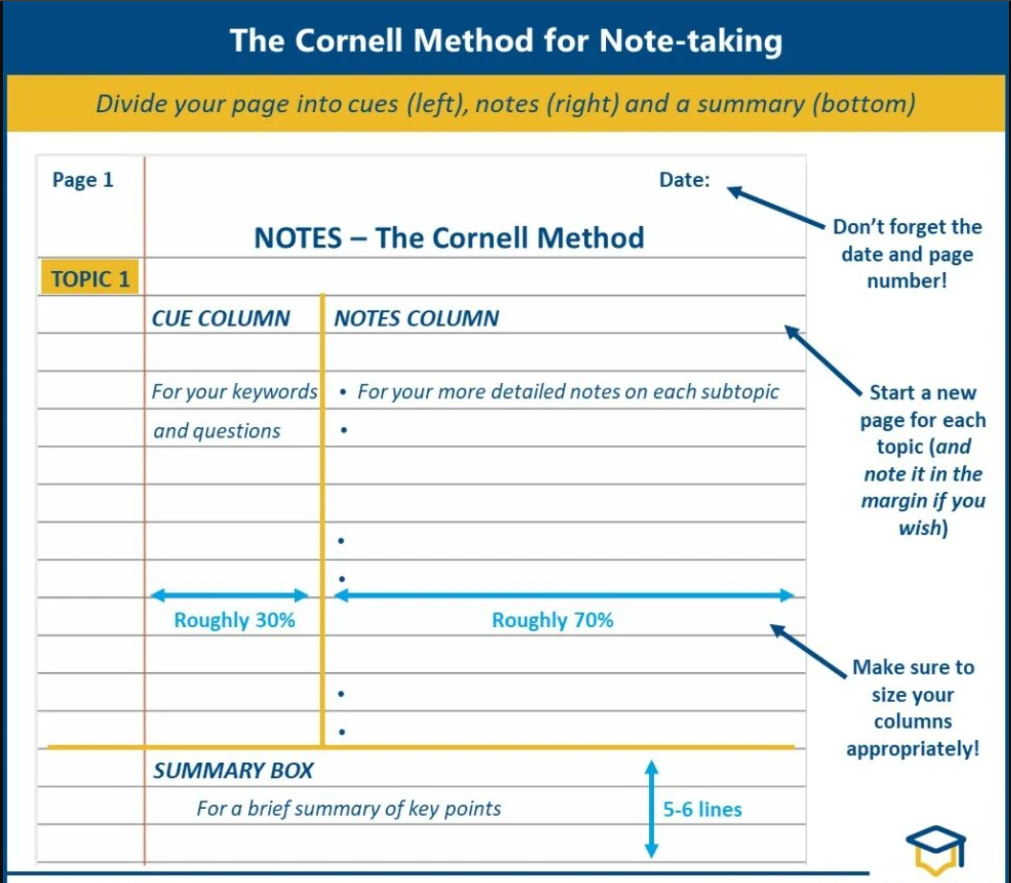
How to Take Cornell Notes (with Pictures) - wikiHow

Slide 14
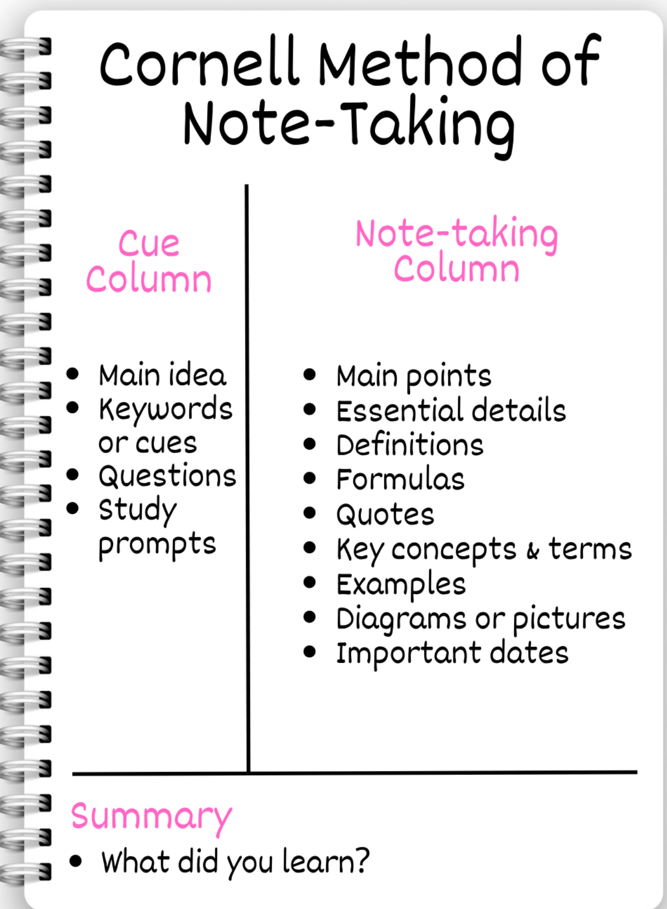

Slide 15
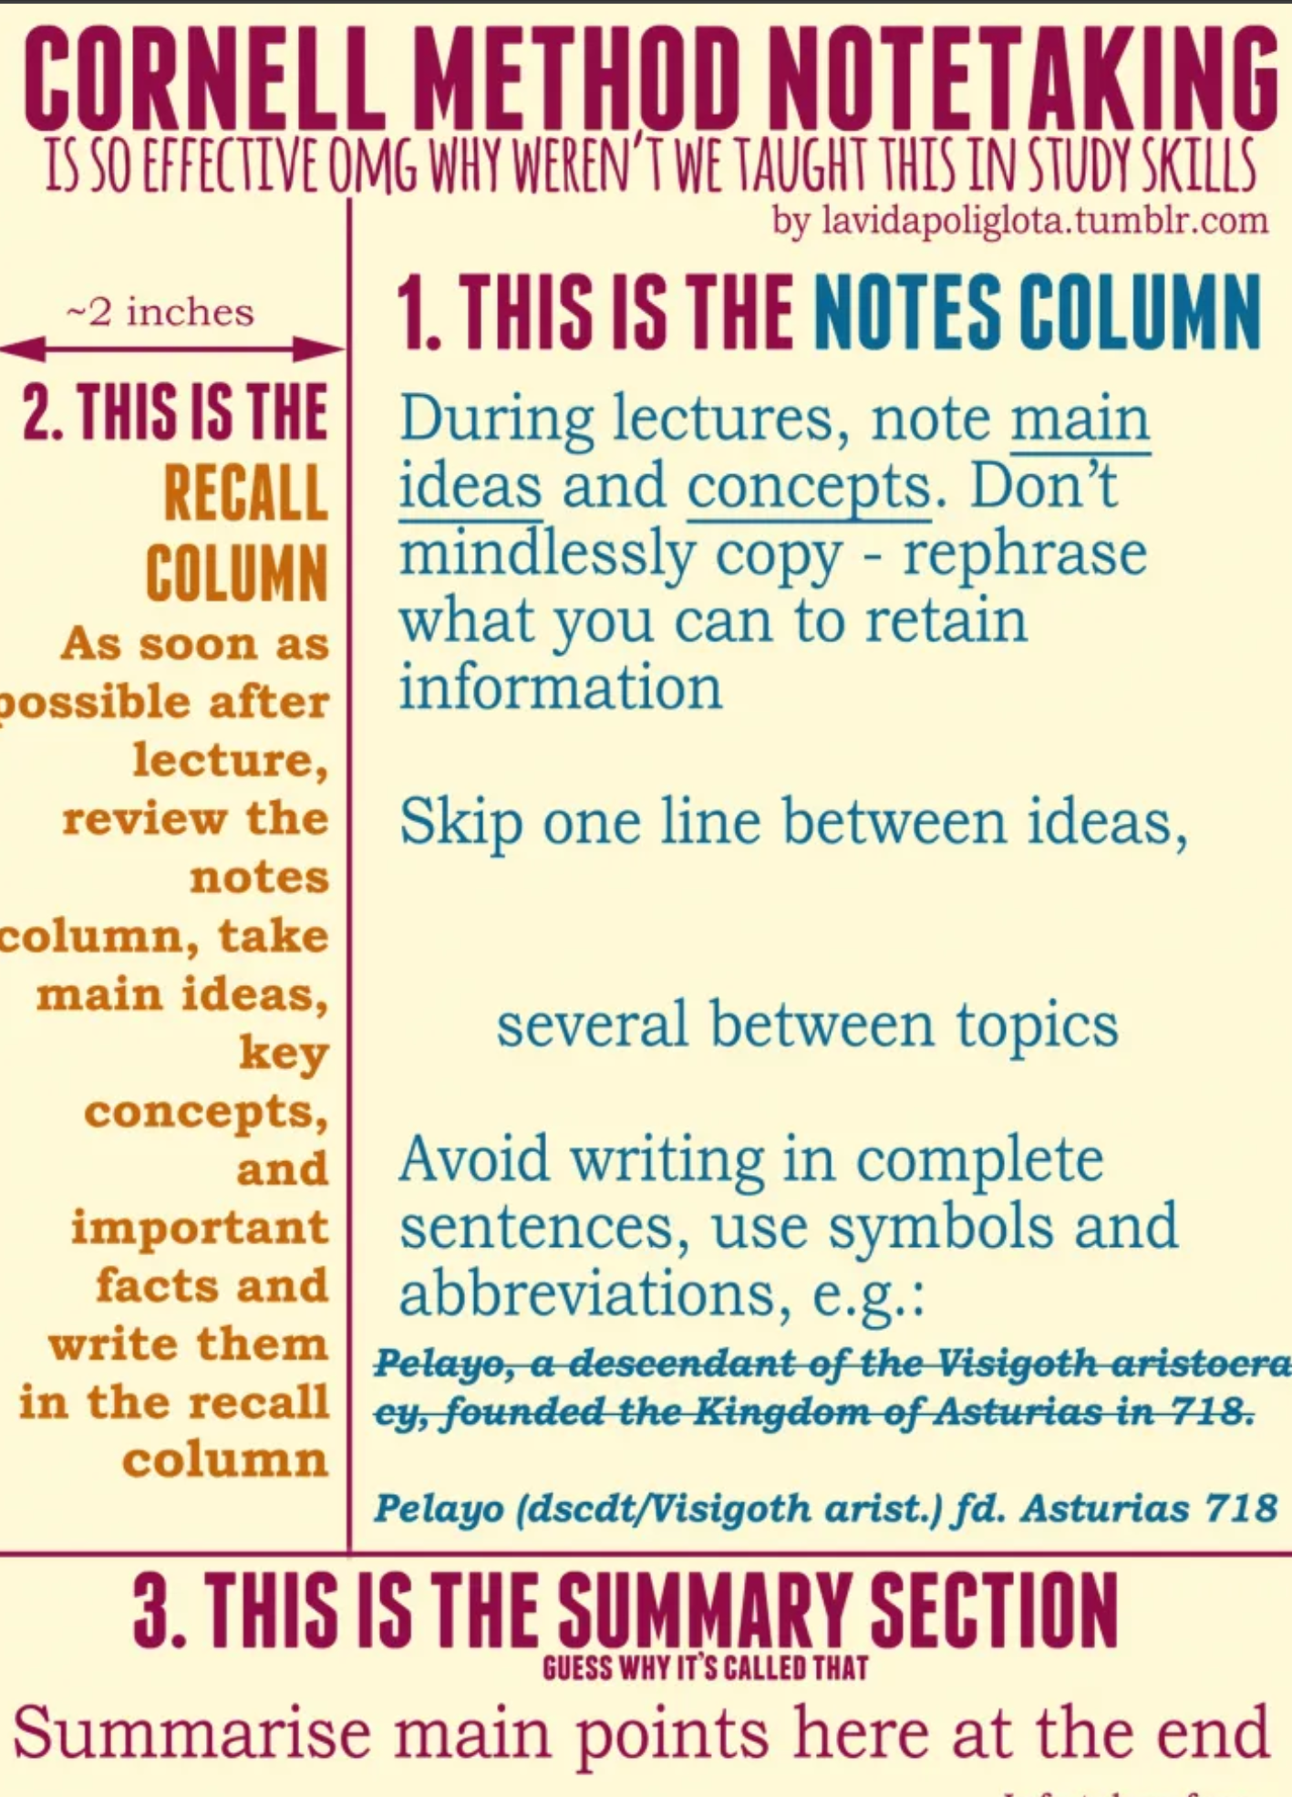

Slide 16
Cornell Notes Example
Topic: Time Management Cue or questions What is procrastination? Why should tasks be prioritised? What makes a plan realistic? Main notes Procrastination means unnecessarily delaying a task. Tasks can be organised according to importance and urgency. A realistic plan includes classes, study, travel, meals and rest. Summary Effective time management requires students to prioritise important work, begin early and create a balanced plan.

Slide 17
What Is Mind Mapping?
A mind map is a visual method of organising information around one central topic.
A mind map usually contains:
  one central topic
  main branches
  supporting ideas
  Keywords
  Colours
  symbols or simple images
  connections between ideas
Mind mapping can be used as a visual approach to note-taking and study.

Slide 18
How to Create a Mind Map
Write the main topic in the centre.
  Add branches for the main ideas.
  Add smaller branches for supporting information.
  Use keywords instead of long paragraphs.
  Use colours to separate categories.
  Add examples, symbols or images.
  Review whether the relationships are clear.
Example central topic: “How to Study Effectively” Possible branches: learning preferences note-taking mind mapping time management VLE revision

Slide 19
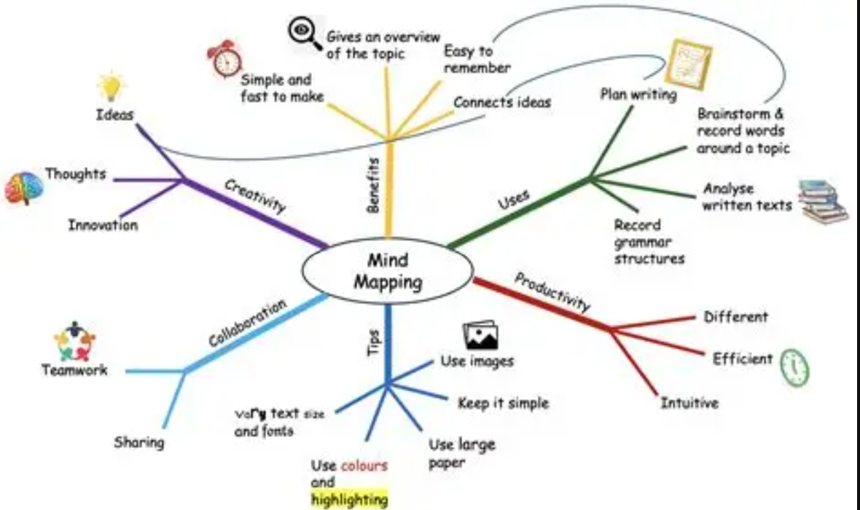

Slide 20
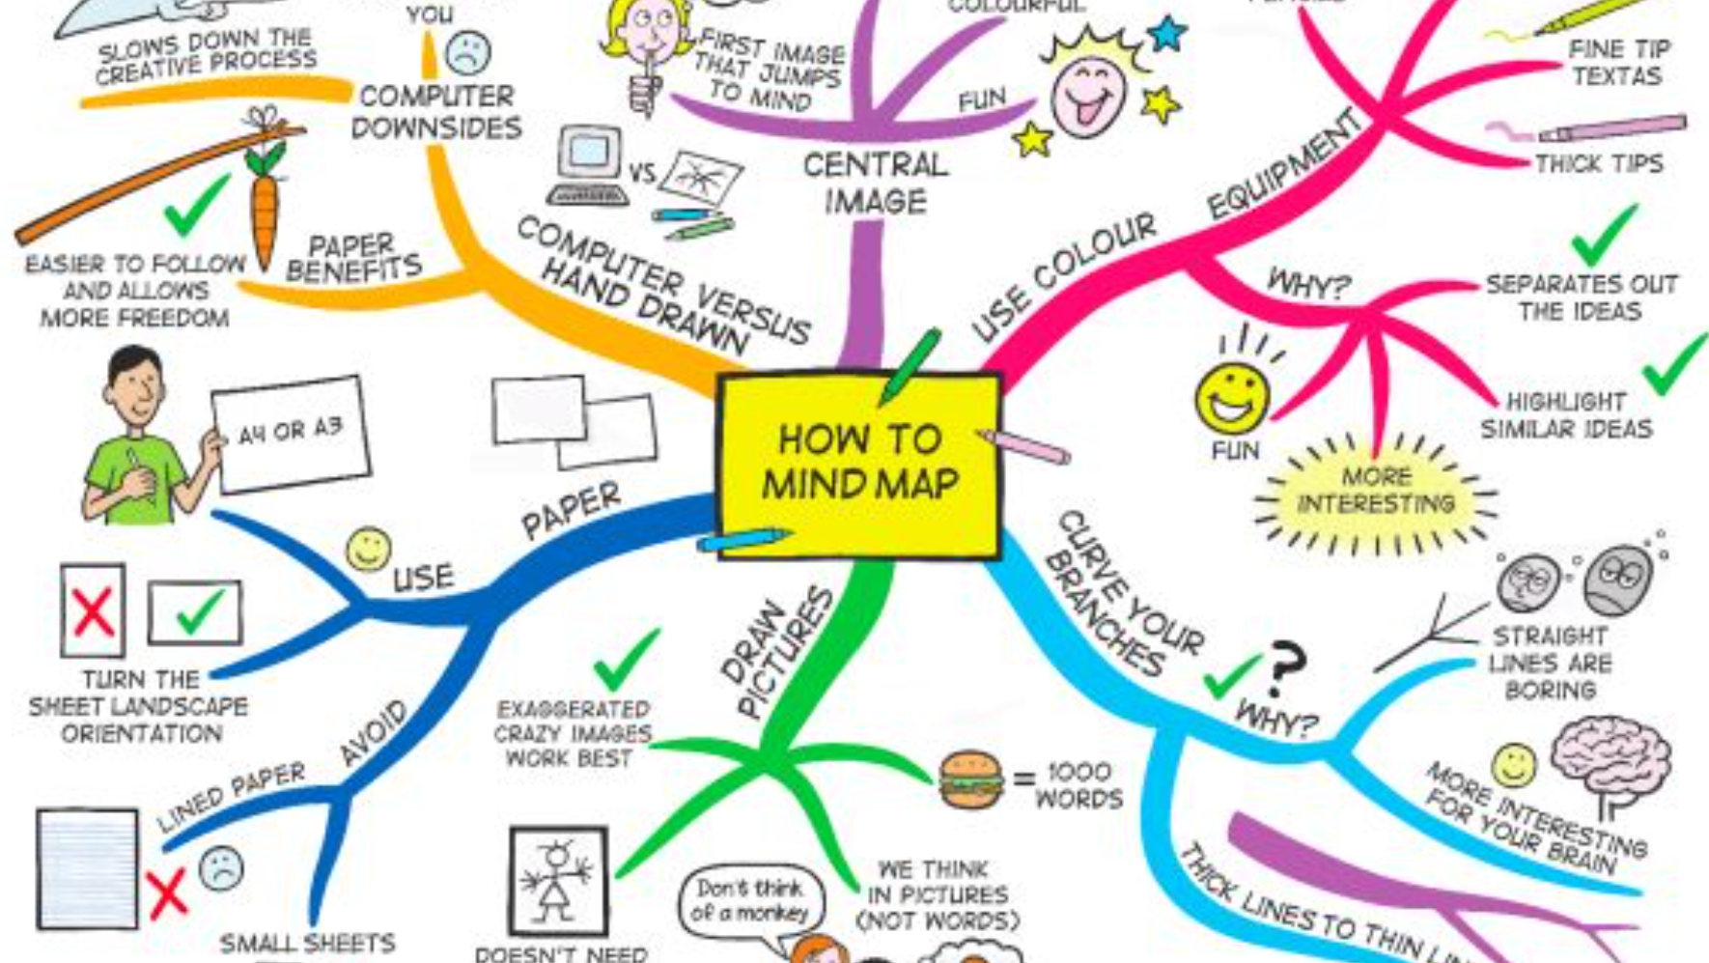

Slide 21
Notes or Mind Map?
Use linear notes when: information follows a clear order detailed explanations are required definitions and examples must be recorded the lecturer presents information step by step Use a mind map when: you need to see the overall topic ideas are connected you are planning an assignment you are summarising a large topic you are preparing for revision Good practice: Students can first create notes and then convert the key information into a mind map.

Slide 22
Why Time Management Matters
Effective time management helps students to: meet deadlines attend classes and complete independent study reduce last-minute pressure balance study and personal responsibilities make time for rest complete work to a better standard monitor academic progress University study-skills guidance links time management with meeting deadlines, completing readings and balancing university and personal life.

Slide 23
Common Time-Management Problems
Students may experience: procrastination distractions from phones or social media unclear priorities unrealistic timetables starting assessments too late forgetting deadlines spending too long on small tasks trying to complete several tasks simultaneously failing to include rest and travel time
Think-Pair-Share: Which problem affects university students most, and why?

Slide 24
Urgent and Important Tasks
Tasks can be divided into four categories: 1. Urgent and important Do these tasks first. Example: An assignment due tomorrow. 2. Important but not urgent Plan when to complete them. Example: Research for an assignment due in three weeks. 3. Urgent but less important Complete quickly, schedule or seek appropriate support. Example: A routine message requiring a simple response. 4. Neither urgent nor important Reduce or remove these activities. Example: Unplanned social-media scrolling during study time.

Slide 25
Creating a Realistic Study Timetable
A useful weekly timetable should include: classes independent study assignment work revision travel meals exercise family responsibilities rest and sleep short productive breaks spare time for unexpected tasks Important: Do not fill every available hour. A timetable must be realistic and flexible.

Slide 26
Breaking Down a Large Assignment
Instead of writing: “Complete my assignment” Break it into manageable tasks: Read the assessment brief. Identify the required sections. Search for appropriate sources. Read and make notes. Create an outline. Write the first draft. Add references. edit and proofread. check the submission requirements. submit before the deadline. Key principle: A large task becomes manageable when it is divided into smaller actions.

Slide 27
Managing Procrastination
To reduce procrastination: begin with one small task remove distractions set a clear study goal use a timer work in focused blocks take planned breaks prepare your study materials in advance reward progress rather than waiting for perfection ask for help before the problem becomes serious Example study pattern: 25 minutes of focused study 5-minute break repeat as appropriate

Slide 28
What Is a VLE?
VLE means Virtual Learning Environment. A VLE is the institution’s online learning platform. It may be used to access: module information lecture slides reading materials announcements assessment instructions submission areas discussion forums feedback and grades calendars and deadlines

Slide 29
Using the VLE Responsibly
Students should: check announcements regularly read the module and assessment information download relevant learning materials check deadlines carefully use the correct submission area keep files clearly named and organised review submission confirmation participate respectfully in online discussions ask for support when technical problems occur Key message: Downloading resources is not the same as learning. Students must read, understand and use them.

Slide 30
Organising Digital Study Materials
Create a separate folder for each module. Example structure: Fundamentals of Study and Employability Lecture Slides Class Activities Homework Portfolio Evidence Reading Materials Assessment Brief Draftss Final Submission Use clear filenames: Week_02_Cornell_Notes.docx Time_Management_Plan.docx Study_Skills_Reflection.docx Avoid filenames such as: document1.docx new final.docx final final latest.docx

Slide 31
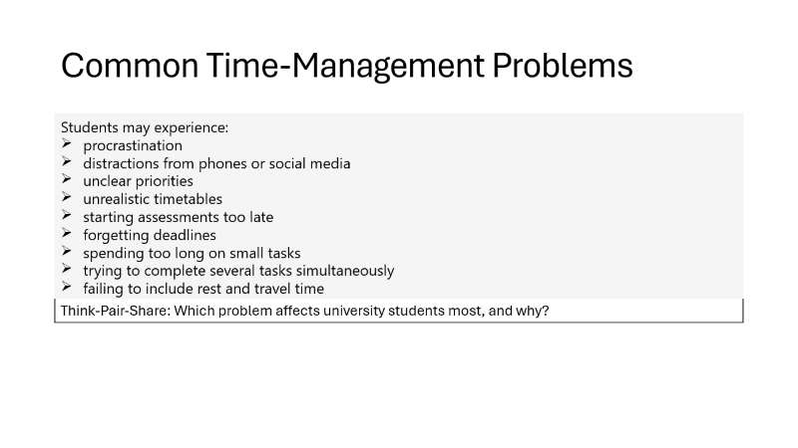
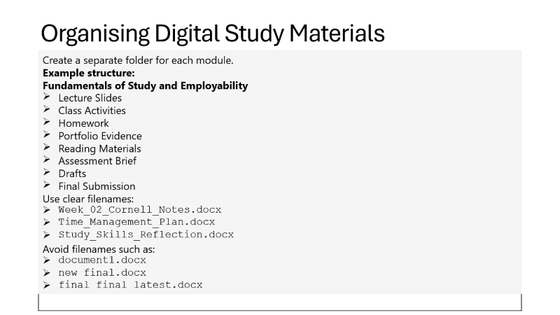
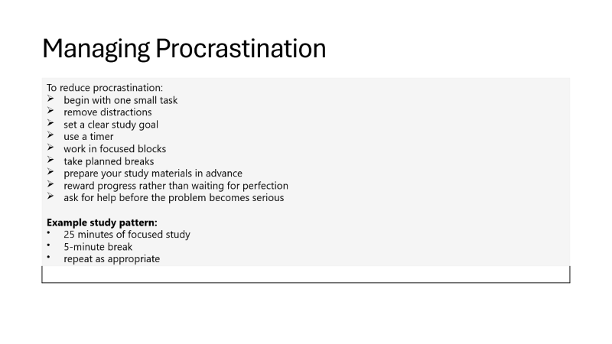
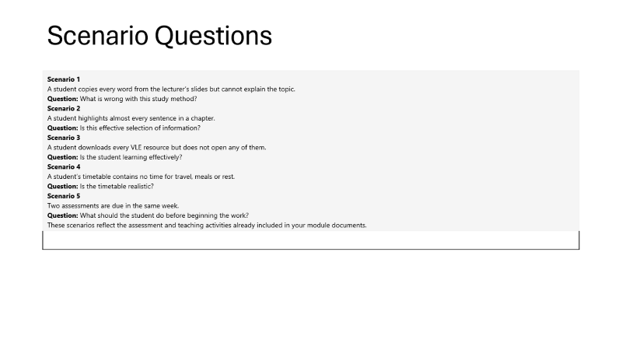
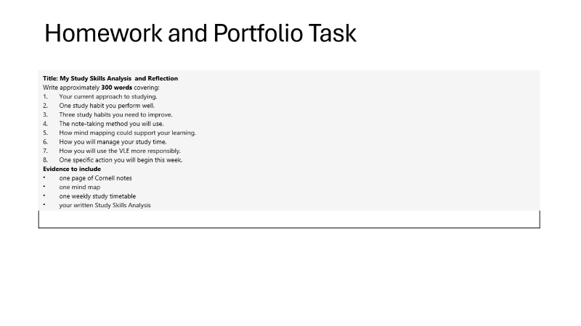
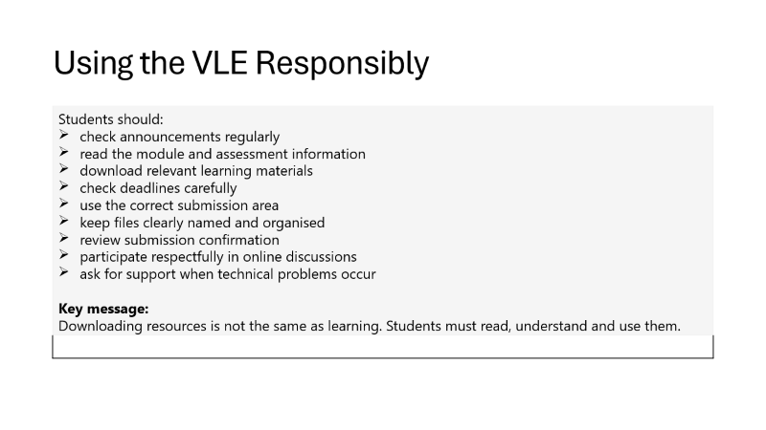
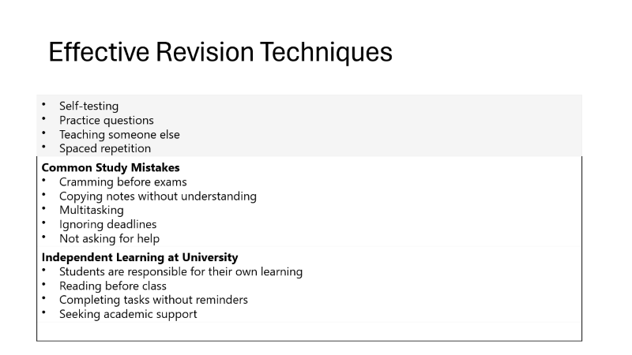
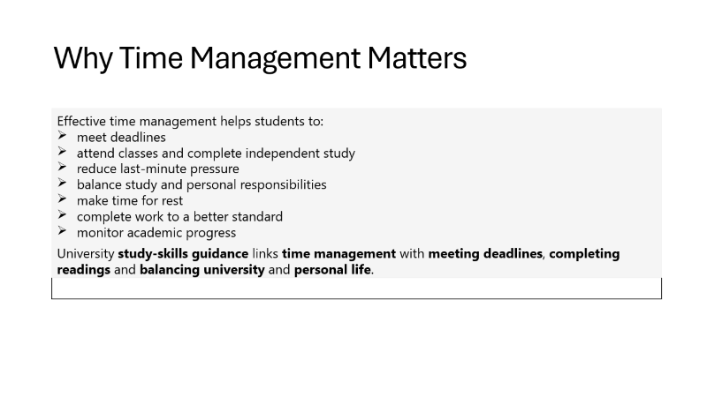
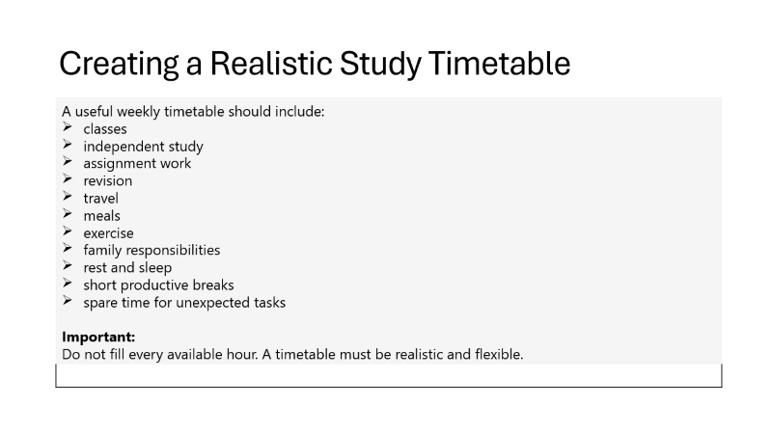
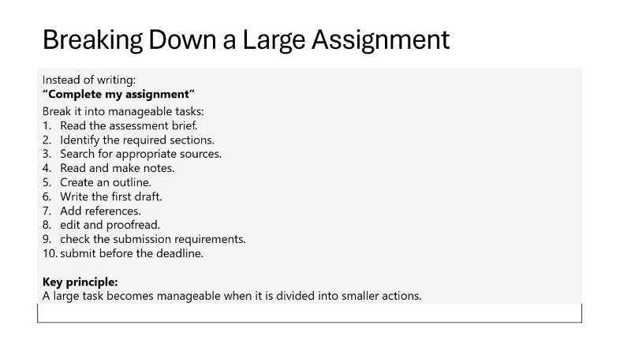
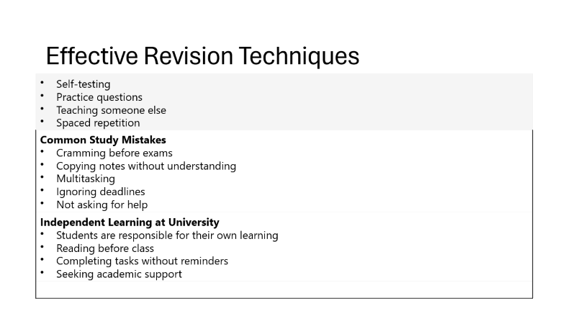
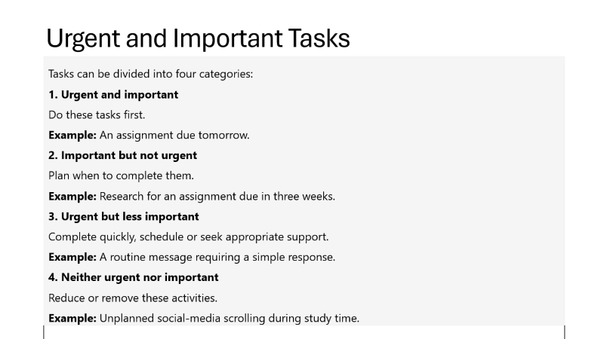
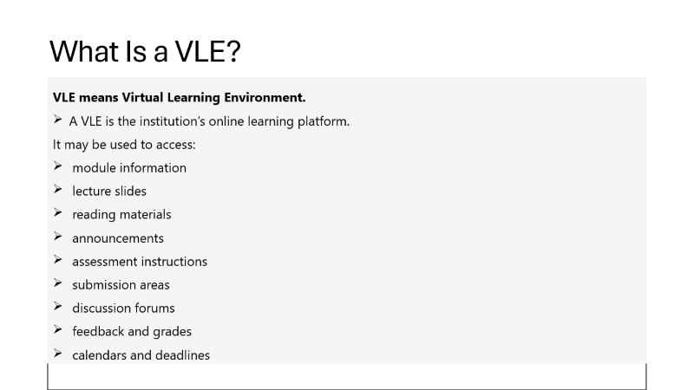
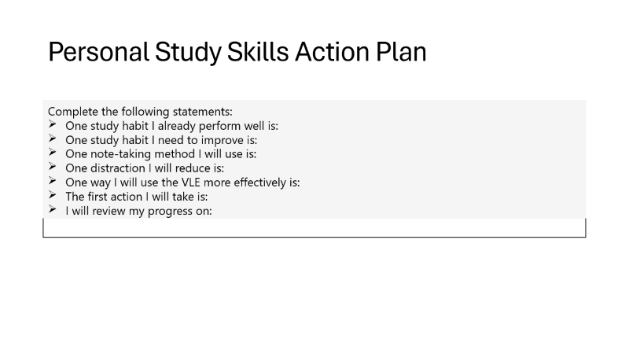
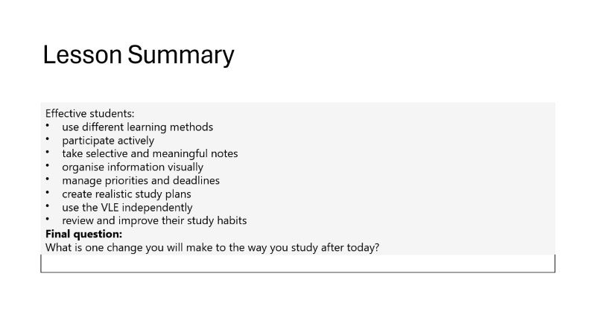
Practical Activity
Study Skills Challenge Complete the following tasks individually: Read or listen to a short explanation provided by the lecturer. Create Cornell notes from the explanation. Identify the most important ideas. Convert the notes into a mind map. Write one question that tests understanding. Identify which method helped you understand the topic better. Explain why that method was useful. Your course plan already connects note comparison, Cornell notes and conversion of notes into a mind map.

Slide 32
Scenario Questions
Scenario 1 A student copies every word from the lecturer’s slides but cannot explain the topic. Question: What is wrong with this study method? Scenario 2 A student highlights almost every sentence in a chapter. Question: Is this effective selection of information? Scenario 3 A student downloads every VLE resource but does not open any of them. Question: Is the student learning effectively? Scenario 4 A student’s timetable contains no time for travel, meals or rest. Question: Is the timetable realistic? Scenario 5 Two assessments are due in the same week. Question: What should the student do before beginning the work? These scenarios reflect the assessment and teaching activities already included in your module documents.

Slide 33
Personal Study Skills Action Plan
Complete the following statements: One study habit I already perform well is: One study habit I need to improve is: One note-taking method I will use is: One distraction I will reduce is: One way I will use the VLE more effectively is: The first action I will take is: I will review my progress on:

Slide 34
Effective Revision Techniques
Self-testing Practice questions Teaching someone else Spaced repetition
Common Study Mistakes Cramming before exams Copying notes without understanding Multitasking Ignoring deadlines Not asking for help
Independent Learning at University Students are responsible for their own learning Reading before class Completing tasks without reminders Seeking academic support

